Slide 1
IP presentation
Nolan Luckett
05/02/18

Slide 2
Introduction
Zynq PS’s I2C Interface
Xylon’s I2S IP

Slide 3
I2C Interface
The Zynq PS provides an I2C interface that can be used to communicate with external hardware.

Slide 4
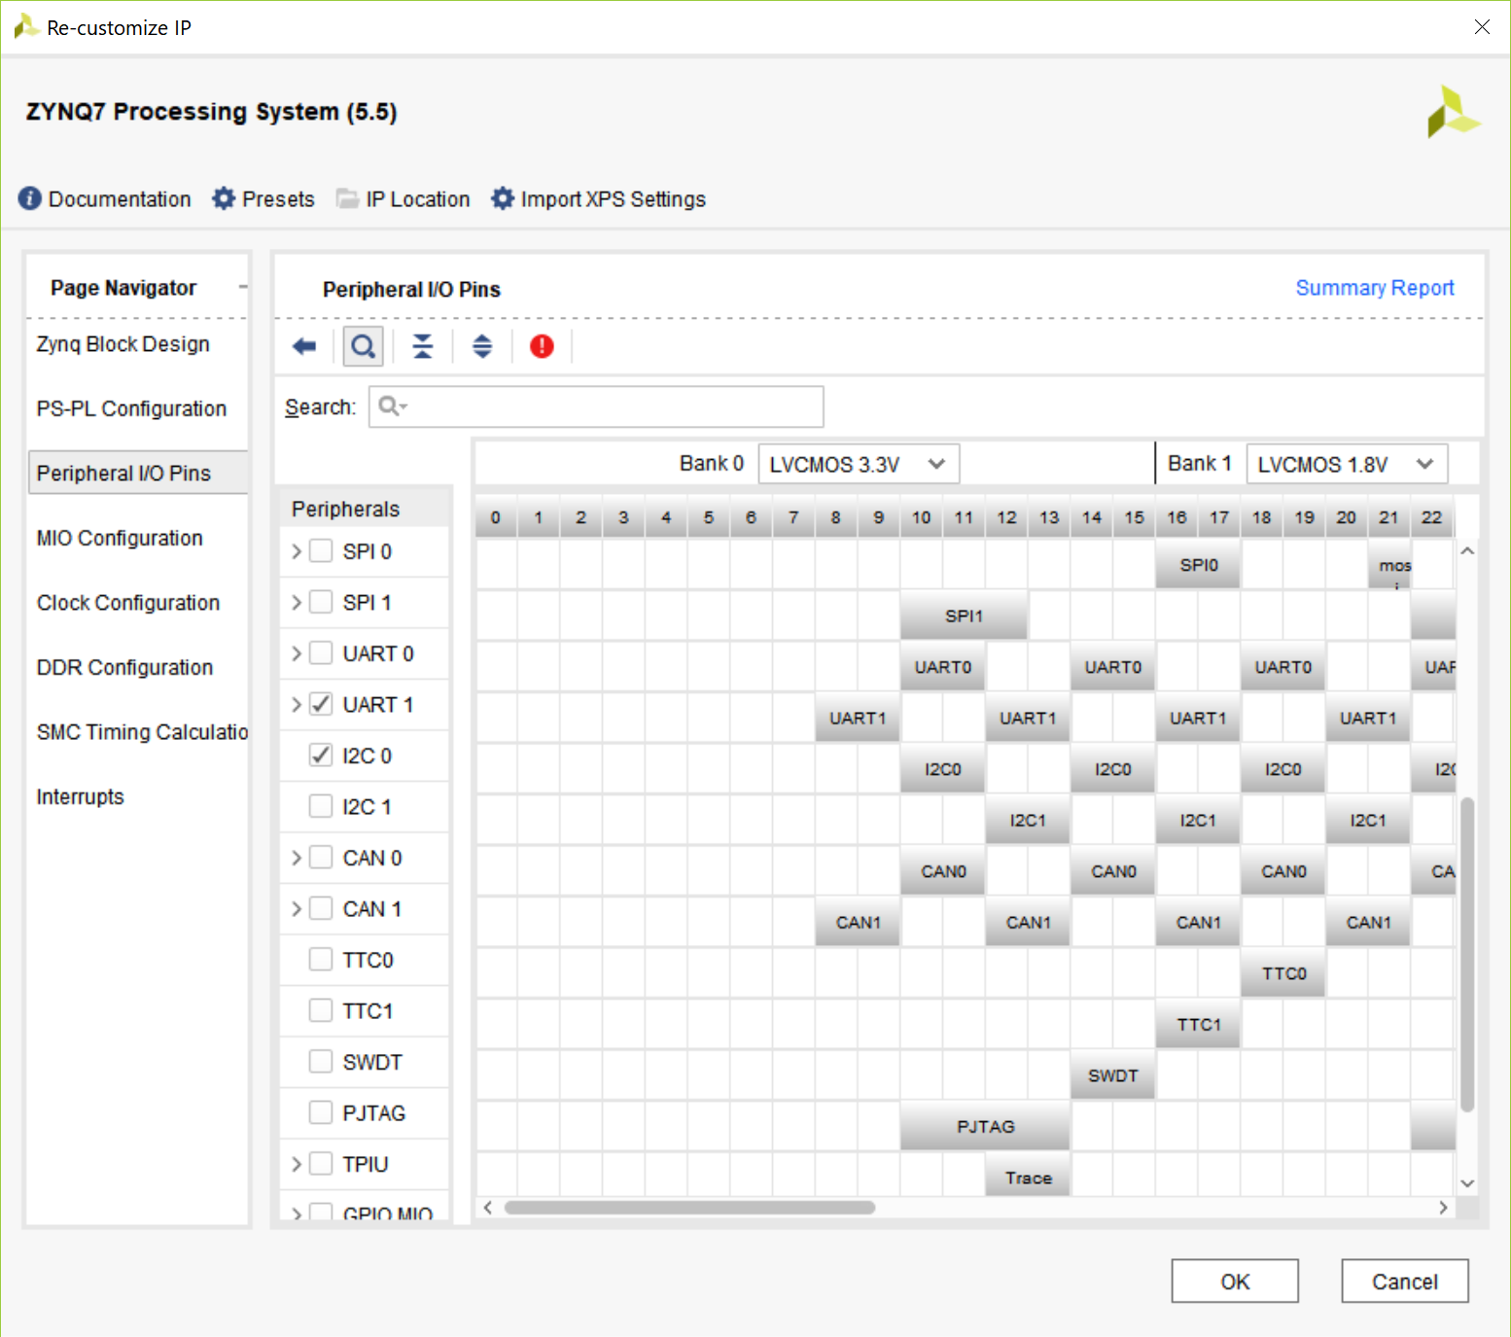
I2C Configuration
Enable the I2C Interface in the Zynq Configuration window

Slide 5
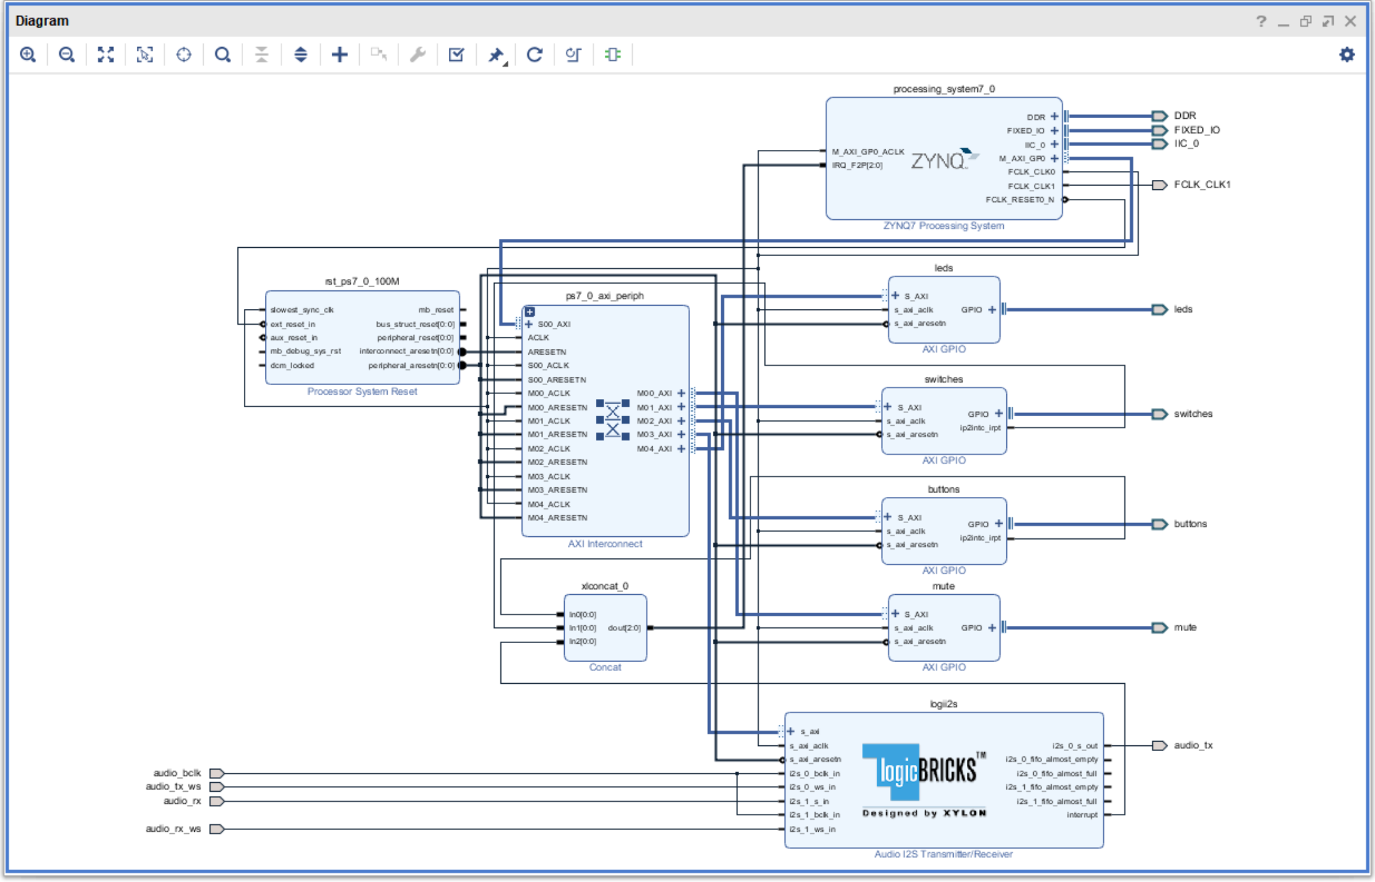
I2C Connections
Connect the I2C output to the audio codec’s serial data and clock lines

Slide 6
I2C Software
Configure the I2C component:
XIicPs_LookupConfig
XIicPs_CfgInitialize
XIicPs_SetSClk
Send address/data
XIicPs_MasterSendPolled
Example Level 1 driver available from the Zynq book

Slide 7
Audio codec configuration
void AudioPllConfig(XIicPs *Iic) {
AudioWriteToReg(Iic, R15_SOFTWARE_RESET, 0b000000000); //Perform Reset
usleep(75000);
AudioWriteToReg(Iic, R6_POWER_MANAGEMENT, 0b000110000); //Power Up
AudioWriteToReg(Iic, R0_LEFT_CHANNEL_ADC_INPUT_VOLUME, 0b000010111); //Default Volume
AudioWriteToReg(Iic, R1_RIGHT_CHANNEL_ADC_INPUT_VOLUME, 0b000010111); //Default Volume
AudioWriteToReg(Iic, R2_LEFT_CHANNEL_DAC_VOLUME, 0b001100000);
AudioWriteToReg(Iic, R3_RIGHT_CHANNEL_DAC_VOLUME, 0b001100000);
AudioWriteToReg(Iic, R4_ANALOG_AUDIO_PATH, 0b000010010); //Allow Mixed DAC, Mute MIC
AudioWriteToReg(Iic, R5_DIGITAL_AUDIO_PATH, 0b000000111); //48 kHz Sampling Rate emphasis, no high pass
AudioWriteToReg(Iic, R7_DIGITAL_AUDIO_I_F, 0b001000010); //Master, I2S Mode, 16 bits
AudioWriteToReg(Iic, R8_SAMPLING_RATE, 0b000000000);
usleep(75000);
AudioWriteToReg(Iic, R9_ACTIVE, 0b000000001); //Activate digital core
AudioWriteToReg(Iic, R6_POWER_MANAGEMENT, 0b000100010); //Output Power Up
}

Slide 8
I2S IP
This IP is provided by Xylon with an evaluation license. It provides an AXI interface for interacting with audio codecs with an I2S interface.

Slide 9
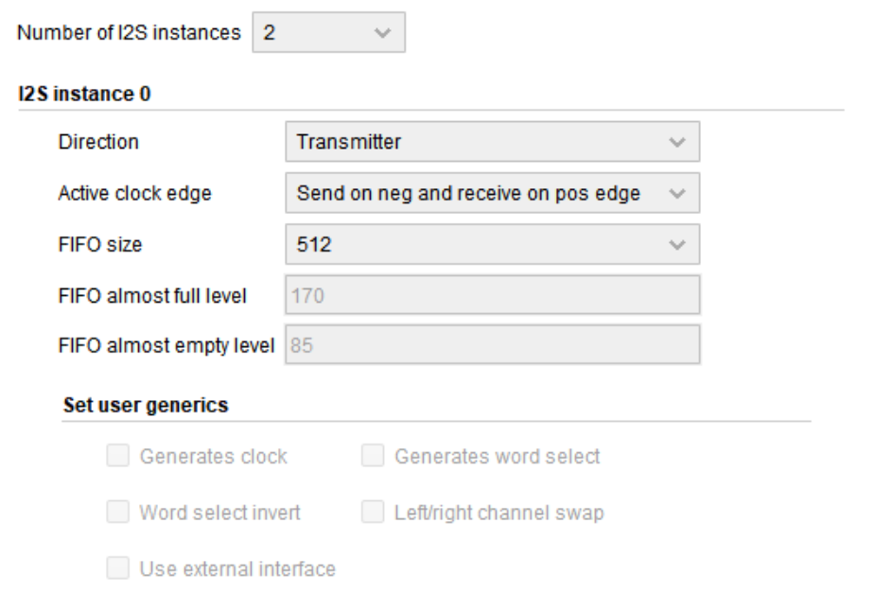
I2S IP Configuration
Configure 2 Instances
1x Transmitter
1x Receiver
Configure both to be clock slaves

Slide 10
I2S IP Connections
Connect the bit and word select clock outputs from the audio codec to the IP.
Connect the Audio inputs and outputs to the IP
Connect the interrupt output to the IRQ_F2P input on the PS, concatenating as necessary

Slide 11
I2s ip driver
A Linux driver was provided, modified for the standalone OS by substituting Linux headers with Xilinx headers. (primarily related to IO)
Level 1 driver providing simplified register interactions for common tasks, e.g:
u32 logii2s_port_read_fifo_word(struct logii2s_port *port);
void logii2s_port_write_fifo_word(struct logii2s_port *port, u32 data);
void logii2s_port_clear_isr(struct logii2s_port *port, u32 bit_mask);
void logii2s_port_enable_xfer(struct logii2s_port *port);
void logii2s_port_disable_xfer(struct logii2s_port *port);

Slide 12
Recording flowgraph
Create Handler for I2S Interrupt:
Configure the GIC
Connect the handler to the event
Enable Recording:
Clear ISR
Unmask Interrupts
Enable Transfer
Interrupt
Process the FIFO Almost Full Event:
Copy the data from the FIFO into memory
Clear ISR

Slide 13
References
Section 5C of “The Zynq Book Tutorials”
Digilent Zybo Reference

